Slide 1
Employee Attrition Prediction
Understand & manage your employees better

Slide 2






Problem & Motivation
A number of employees leave due to various reasons
Waste of time & money on training those employees
Aim to increase the effectiveness of employee management & better allocate their resources.

Slide 3

Web App Demo
http://msia423-935455349.us-east-1.elb.amazonaws.com/about

Slide 4

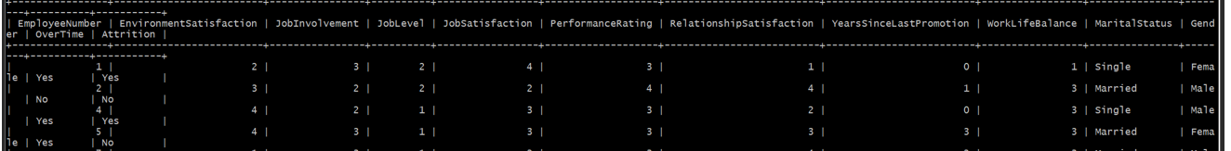
Data Description
Source: https://www.kaggle.com/datasets/colearninglounge/employee-attrition
A set of data points on the employees who are either currently working within the company or have resigned.
With features related to attrition
RDS usage:
Store processed data (related employee features and corresponding attrition results)
Store newly added employee data (from user input)

Slide 5
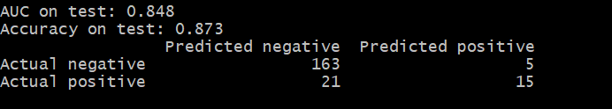
Model
Random Forest Model:
Offline model
Binary classification
Success criteria:
AUC
Accuracy

Slide 6
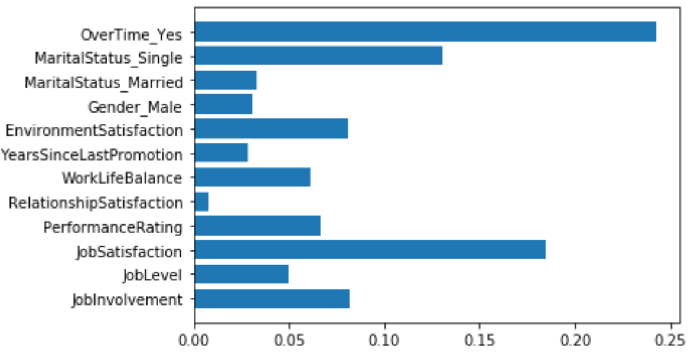
An interesting insight
Working Overtime is most likely to result in employee attrition

Slide 7
Thank you!
Contact: Chenxinyang2022@u.northwestern.edu

